Slide 1
Welcome

Slide 2
Presentation by
MITHUN CHANDRA DAS

Slide 3
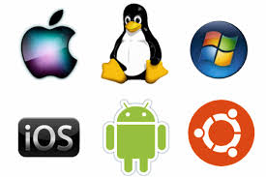
OPERATING SYSTEMS

Slide 4
TABLE OF CONTENTS
what is operating system.
What OS does?
How many types of OS.
Components of OS.
Common OS history.
Common OS difference.
How many kinds of device which uses OS.
Advantage of OS.
Disadvantage of OS.

Slide 5
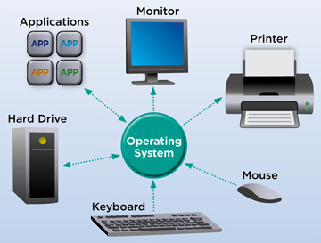
The most important program that runs on your computer. It manages all other programs on the machine.

Slide 6
What OS does?
An operating system performs basic tasks such as…
controlling and allocating memory
prioritizing system requests
controlling input and output devices
facilitating networking and
managing file systems

Slide 7
How many types of OS?
Single user single task.
Multi user multi task.
Real time operating system.
Single user multi task.

Slide 8
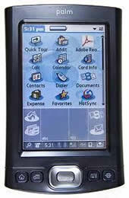
Single user single task This type manages the computer so that one user can effectively do one thing at a time

Slide 9

Multi user multi task Allows two or more users to run programs at the same time. Some operating systems permit hundreds or even thousands of concurrent users.

Slide 10
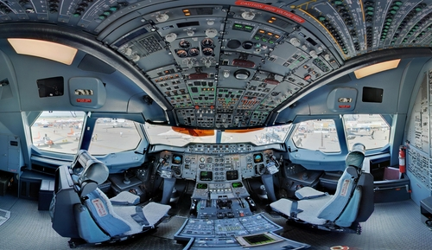
Real time operating system RTOS are used to control machinery, scientific instruments, and industrial systems. There is typically very little userinterface capability.

Slide 11

Single user multi task This is the type of operating system most desktops and laptops use today. Microsoft’s Windows and Apple’s MacOS are both examples of operating systems that will let a single user have several programs in operation at the same time.

Slide 12
Five Main Components Of An Operating System
Process management.
Memory management.
Disk and file systems.
Networking.
Security.

Slide 13

Common Operating system and their history LINUX This operating system first released on September 17, 1991 by Linus Torvalds. It is free and open source OS .

Slide 14
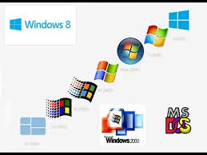
WINDOWS Microsoft introduced an operating system named Windows on November 20, 1985, as a graphical operating system shell for MS-DOS .

Slide 15
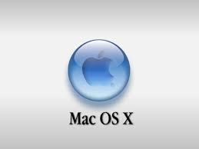
MAC OS The family of Macintosh operating systems developed by Apple. In 1984, Apple debuted the operating system that is now known as the Mac OS. The current Mac operating system is macOS,originally named "Mac OS X" until 2016.

Slide 16
COMMON OPERATING SYSTEM AND THEIR DIFFERENCE
1. Network Operating System
- UNIX/LINUX.
2. Desktop Operating System
- Ms windows/Mac OS/DOS.
3. Mobile Operating System
- palm OS.

Slide 17
Example of Computing device which use OS
Coumputer
Mobile phone
3d televisions
Video games
ATM
Ticket wending machine etc.

Slide 18
Advantage of OS
Easy to use.
User friendly.
No need to know any technical language.
It’s the platforms of all programs.

Slide 19
Disadvantage of OS
1. If any problem affected in OS you may be lose
all the contents which have been stored already.
2. Unwanted user can use your own system.

Slide 20


Slide 21


